Slide 1


Cipher Vault The ultimate solution for securely storing and managing your confidential , all in one place.

Slide 2
Thanking for the wonderful guidance
Prof.Deepak Kumar Verma
Our Project Guide & Faculty
Dept. of Computer Science & Engineering.
Prof. Arshad Usmani
Faculty & Head of the department.
Dept. of Computer Science & Engineering.

Slide 3
Participants:
AMAN KUMAR SINGH.
[2K19/CSE/D07]
RAGHAV KUMAR SINGH.
[2K19/CSE/D26]

Slide 4
TABLE OF CONTENTS:-
Objective
Introduction
Technology & Platform overview
Application Feature overview
Conclusion

Slide 5

OBJECTIVE:
We aim at building an application which ensure the security of data or files contains important details to be safe and secure .
Since the security of any digital information from unauthorized access is fully not secure in network.
It is developed to make reliable transfer and storing of data.
To reducing the risks of data loss or corruption.

Slide 6
INTRODUCTION
The applications employs advanced encryption algorithms to ensure that user data is protected at all times.
With its powerful encryption, user friendly interface and robust features.
Once such solution is project cipher vault to ensure confidentiality ,integrity ,and availability of data through a combination of cryptographic techniques.
It will help to automate the complete lifecycle of security approach.

Slide 7
Gantt chart of the project: [march2023–april2023]
 | 1st Week |  | 2nd Week |  |  |  | 3rd Week |  |  | 4th Week | 5th Week |  | 6th Week | 7th Week |  |  |  |  | 8th Week
Feasibility study
Analysis
documentations
planning
coding
testing
bug fixing
Final project

Slide 8


Slide 9
Technology & Platform overview

Slide 10

Cryptography
Cryptography is the practice of securing communication and data by converting it into a code that can only be read by authorized users.
Cryptography has been used for centuries to protect sensitive information, such as military secrets, trade secrets, and personal information.
Cryptography uses various techniques, such as encryption, decryption, hashing, and digital signatures, to protect the confidentiality, integrity, and authenticity of the data.
Cryptography plays a crucial role in securing our digital world and protecting our privacy, and it is an essential tool for ensuring the confidentiality, integrity, and authenticity of our data.

Slide 11

Encryption Methods
Advanced Encryption Standard (AES).
Secure Hash Algorithm (SHA).
Transport Layer Security (TLS).
Elliptic Curve Cryptography (ECC).
Password-Based Key Derivation Function (PBKDF2).

Slide 12
Advanced Encryption Standard (AES).
AES stands for Advanced Encryption Standard, which is a widely used symmetric encryption algorithm.
It was adopted by the US government in 2001 as a replacement for the outdated Data Encryption Standard (DES).
AES operates on fixed-length blocks of data and the standard block size for AES is 128 bits.
AES uses a symmetric key, which means the same key is used for both encryption and decryption.
The key length can be 128 bits, 192 bits, or 256 bits, and the security of the cipher increases with the key length.
AES applies a series of transformations using the key to produce ciphertext, including substitution, permutation, and XOR operations.

Slide 13
Secure Hash Algorithm (SHA)
SHA is a family of cryptographic hash functions developed by the National Security Agency (NSA) in the United States.
SHA is designed to take an input (message) of any length and produce a fixed-size output (hash value).
The output of a SHA function is a unique, fixed-size digest or hash value, which can be used to verify the integrity and authenticity of a message.
SHA is widely used for digital signature schemes, password storage, and other applications that require message authentication and integrity.

Slide 14
Transport Layer Security (TLS).
TLS is a cryptographic protocol used to provide secure communication over the Internet.
TLS is used to establish a secure connection between a client and a server, and it can be used with a variety of application layer protocols, such as HTTP, SMTP, and FTP.
TLS provides confidentiality, integrity, and authentication of the data transmitted over the network.
TLS uses a combination of symmetric and asymmetric encryption to secure the communication.
TLS uses a handshake protocol to negotiate the parameters of the encryption, such as the cipher suite, key exchange method, and digital certificates.
TLS also uses a digital certificate to authenticate the identity of the server and, optionally, the client.

Slide 15
RSA
RSA is named after its inventors Ron Rivest, Adi Shamir, and Leonard Adleman.
RSA is based on the difficulty of factoring the product of two large prime numbers. The larger the numbers, the harder it is to factor their product and break the encryption. To encrypt a message using RSA, the message is first converted to a number, and then raised to the power of the public exponent modulo the public modulus.
To decrypt a message using RSA, the ciphertext is raised to the power of the private decryption exponent modulo the private modulus.
RSA can be used for digital signatures as well as encryption. A digital signature is created by hashing a message and then encrypting the hash with the private key.
RSA is widely used in secure communications, such as secure web browsing and email encryption.

Slide 16

Eclipse is an open-source integrated development environment (IDE) that is widely used for Java development. Eclipse provides a wide range of features, such as code editing, debugging, testing, and version control, that can help you develop high-quality software faster and more efficiently. Eclipse has a large and active community of developers who contribute to its development and provide support through forums and online resources. Eclipse is highly customizable and extensible, and it supports a wide range of plugins and extensions that can enhance its functionality and make it easier to work with. Eclipse provides a user-friendly and intuitive interface that is easy to navigate, making it ideal for beginners and experienced developers alike.

Slide 17
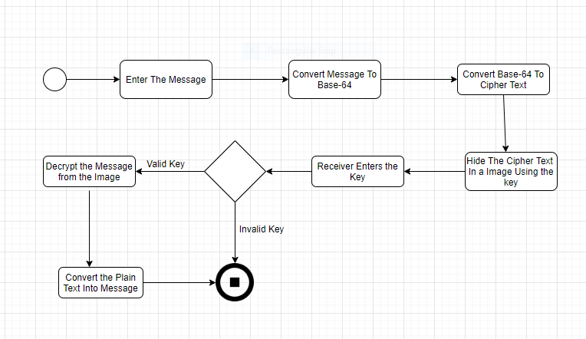

Slide 18
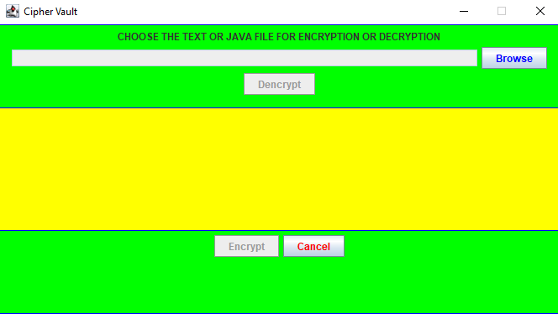

Slide 19
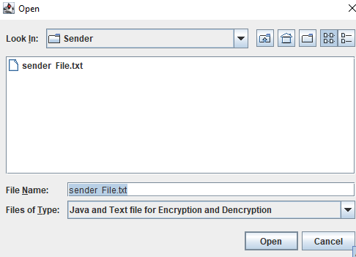

Slide 20
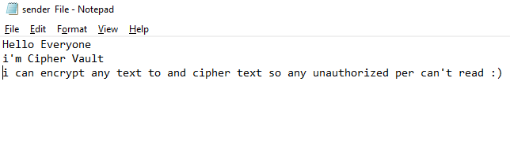

sender side
INPUT FILE
ENCRYPTED FILE

Slide 21
Receiver side
ENCRYPTED FILE
OUTPUT FILE

Slide 22
APPLICATION FEATURES OVERVIEW
Encryption and decryption is done using asymmetric method .
It provide confidentiality and reliable in attempt to hide the existence of the data.
The aim is to hide the data using steganography and ensure the quality of concealing data must not be lost.
It doesn’t need internet connectivity.

Slide 23
CONCLUSION
This project is designed by using the steganography and cryptography features factors for better performance.
We concluded that in our method the text files and RSA Cryptography are better . Because of their high capacity. Results achieved indicate that our proposed method is encouraging in terms of security and robustness.

Slide 24
"Good cryptography is characterized by the fact that it provides confidentiality, integrity, and authenticity without getting in the way." - Bruce Schneier

